Slide 1
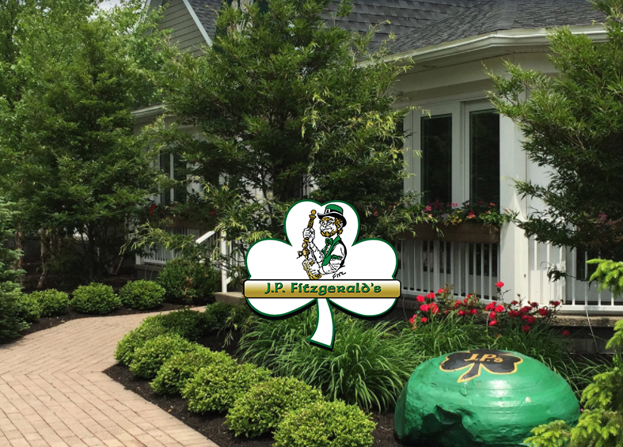
J.P. Fitzgerald’s

Slide 2
Company History
Founded in 1990 by Robert Brunner
Named after owner’s Grandfather
“The Village Edge”
2nd Restaurant in Western New York with website

Slide 3
Operations
Casual Dining Atmosphere
5 Servers
Bar-Room
Banquet Room
Patio

Slide 4
J.P.’S Dining Rooms 2017

Slide 5
Creating Business Value
Management has been and is successful, so how to create value?
Gaps in data analysis?
How to use data to our advantage?

Slide 6
Front of House Implications
Voids are the removal of given menu items from customer’s bill
Only authorized employees may void order items
Void Slip contains order info and what has been removed
Also includes “Voider” and the employee who has been responsible for servicing the order
Orders are In-House or Take-Out

Slide 7
Value Created
Identifies trends not otherwise seen
Pinpoint what days need attention
Item quality
Platform service Improvements

Slide 8
Link to Group Website
djmsconsultinggroup.weebly.com

